Slide 1
Business Ethics & the use of data
Aug 1, 2018

Slide 2
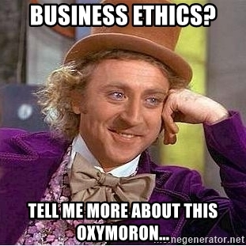
Does anyone have a definition of business ethics?
In 1970, Milton Friedman famously argued that the only social responsibility of business was to maximize profits.
“The only business of business is business” -President Calvin Coolidge

Slide 3
Does anyone have a definition of business ethics?
A set of behavioral standards informing and justifying your actions while transacting business, commerce etc.

Slide 4
What about in the context of data, machine learning & AI?

Slide 5
What about in the context of data, machine learning & AI?
Does using data and algorithms justify actions? The use of data and mining approaches can be audited and are logical, so are the outcomes of those efforts justified?

Slide 6
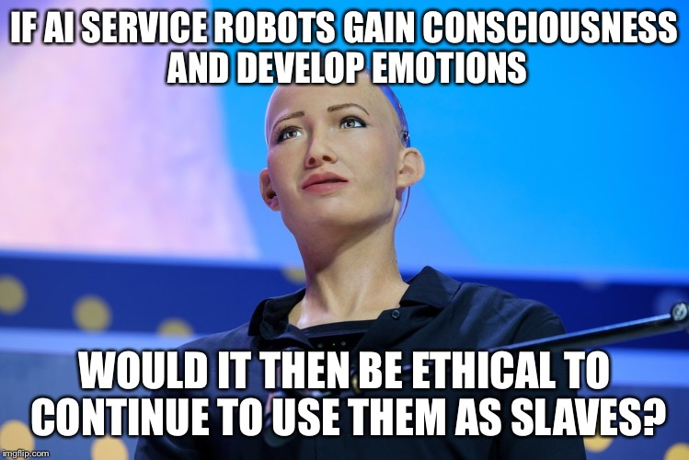
What about in the context of data, machine learning & AI?

Slide 7

Article 1
Is there a business and data ethics question? Who was impacted?
If so, what did the practitioners and leaders miss?
What could have been done to mitigate the impact?
Does HFT provide liquidity? Does it negatively impact everyday investors? Do they provide real economic value? Short term the market is a negative sum transaction due to these market makers is that fair for the middle class saver or pension holder?

Slide 8

Article 2
Is there a business and data ethics question? Who was impacted?
If so, what did the practitioners and leaders miss?
What could have been done to mitigate the impact?
Is predicting simply spying and a form of privacy invasion? Is Target being underhanded by masking their intent with non pregnancy coupons? Are consumers manipulated by these tactics or is it a benefit?

Slide 9

Article 3
Is there a business and data ethics question? Who was impacted?
If so, what did the practitioners and leaders miss?
What could have been done to mitigate the impact?
Is optimizing a schedule the best for the company, its shareholders, its customers and even employees since that ensures success of the company and leads to job stability? Or does SBUX have a duty to employees as human beings with varying social-economic situations?

Slide 10

Article 4
Is there a business and data ethics question? Who was impacted?
If so, what did the practitioners and leaders miss?
What could have been done to mitigate the impact?
Was it marketing ignorance, merely aspirational claims, or truly conscience misleading? Does that matter to patients? What duty do the technical folks have to inform of limitations to sales, business and customers? What duty do business leaders have to question of the technical creators? What duty do the customers have to thoroughly review?

Slide 11

Article 5
Is there a business and data ethics question? Who was impacted?
If so, what did the practitioners and leaders miss?
What could have been done to mitigate the impact?
Harmless marketing stunt that turned ugly? If we have to filter the training data and provide guardrails do we invite censorship & bias? What if Tay was supposed to make cancer recommendations, pick stocks for your retirement, recommend purchases, or schedule an appointment? Letting it loose with public info let it be corrupted almost immediately but once the scientist applies limitations to inputs, bias is introduced.

Slide 12
Some Popular Ethical Paradigms
Name | Proponent | Description | Example
Categorical Imperative | Kant | Make your action a universal law to see if it is ethical. Taken to an extreme, if the action becomes illogical, then it is immoral. | For stealing property…if everyone stole all property whenever they wanted then property itself loses all value making your act illogical. Therefore stealing is unethical.
Golden Mean | Plato/Socrates | Virtuous actions are between two extremes, deficiency and excess. Thus one should sometimes be courageous and at other times cowardice.
Utilitarianism Self –interest Common Good | Mill | Ethical decisions are those that maximize happiness and minimize pain. “it’s ok to hurt a small group to maximize the gain for the larger group.” | Vaccines can cause significant problems so the government set up a fund to help victims of vaccine side affects. Vaccines benefit society by eradicating disease.
Rights based | Locke | Humans beings are an “end” not a “means” and should be treated that way. | All human being have the right to dignity and other debated rights. Does this extend to animals? Conscience robots?
….MANY OTHERS | … | … | …

Slide 13
Popular Ethical Paradigms
As you become a business leader or technician, having predefined values will help you in the moment.

Slide 14
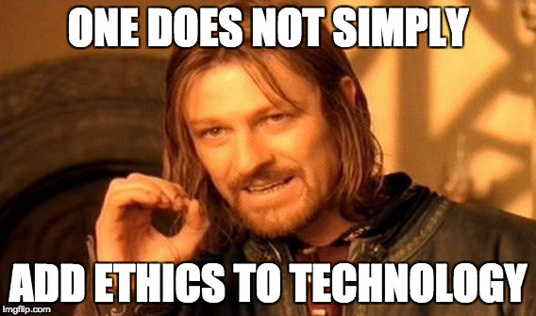
This is my evolving definition.
Despite being justified with data and logical methods (e.g. algorithms), a just data based business decision is one that additionally understands the moral implications and humanistic impact.
For me, technology for technology sake isn’t appropriate. It is a means not an end.
Blindly stating these techniques represent progress is misleading.

